Slide 1

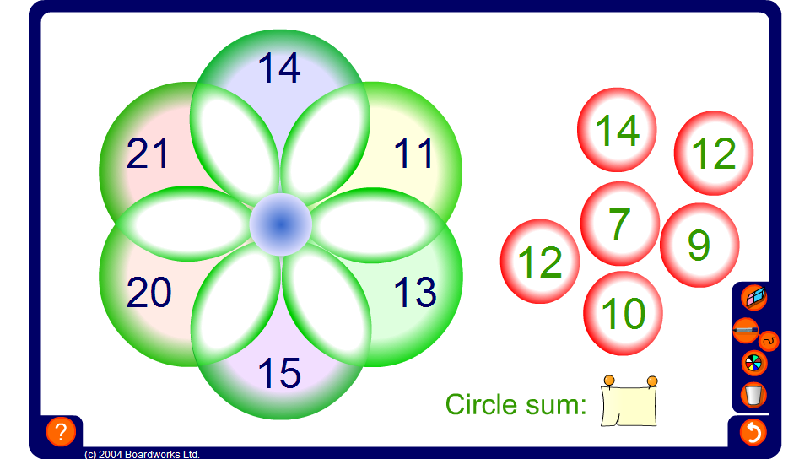


Circle sums – whole numbers
Notes:
Explain to pupils that in this puzzle, the numbers on the right have to be dragged into each intersection so that the sum of the three numbers in each circle is the same.
The ‘circle sum’ can be hidden or revealed to make the puzzle more or less difficult.
The circle sum puzzle on this slide uses whole numbers.

